Slide 1




Carson City Regional Transportation Stakeholder Coalition (RTSC)
June 20, 2022

Slide 2
Agenda
Opening!
General Division Updates – Chris Martinovich
CAMPO Public Participation Plan– Kelly Norman
District 1 Projects and other project activities – Bryan Byrne
Open discussion – All

Slide 3
General Division Updates
Staffing
US 395 Southern Sierra Corridor Study
US 50 E. Carson Corridor Study
NVE Zero Emission Transition Plan
Local Roadway Funding
Local Road Safety Plan

Slide 4
CAMPO PPP
The CAMPO Public Participation Plan (PPP) guides outreach efforts for the agency’s RTP, TIP, UPWP, and other transportation planning studies, as appropriate. The draft CAMPO Public Participation Plan is the culmination of months of work reviewing, interviewing, and evaluating to inform CAMPOs public outreach process.
Reviewed Federal & State Requirements
Interviewed peer, local, state, and federal agencies
Evaluated existing practice
Outreach survey
The draft CAMPO PPP is open for comments through June 28th!
Please review the draft PPP @ www.CarsonAreaMPO.com and provide comments to campocomments@carson.org or www.Carson.org/Connect

Slide 5
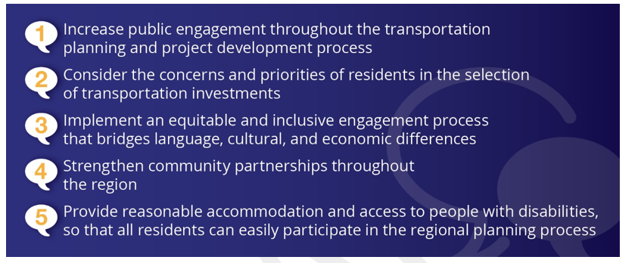
CAMPO PPP
CAMPO Public Participation GOALS
The draft CAMPO PPP is open for comments through June 28th!
Please review the draft PPP @ www.CarsonAreaMPO.com and provide comments to campocomments@carson.org or www.Carson.org/Connect

Slide 6
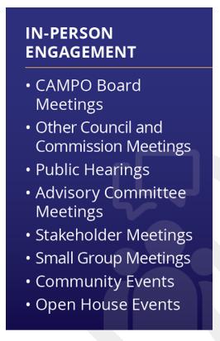

CAMPO PPP
The draft CAMPO PPP is open for comments through June 28th!
Please review the draft PPP @ www.CarsonAreaMPO.com and provide comments to campocomments@carson.org or www.Carson.org/Connect

Slide 7

1). Do you feel that transportation planning is important to you and/or your family? (yes/no)
Answers | Count | Percentage
Yes | 99 | 95.19%
No | 5 | 4.81%

Slide 8
2). How would you prefer to receive information or interact with CAMPO staff in transportation planning?
Answers | Count | Percentage
Social Media | 53 | 20.08%
In-person meetings | 31 | 11.74%
Online meetings | 27 | 10.22%
Television or radio | 16 | 6.06%
Project websites | 57 | 21.59%
Online interactive tools | 43 | 16.29%
Mail | 24 | 9.09%
Other | 13 | 4.93%

Slide 9
3) In what types of transportation planning are you most likely to participate?
Answers | Count | Percentage
Transportation safety | 44 | 17.12%
Roadway planning | 64 | 24.90%
Public transportation | 46 | 17.91%
Bicycle and pedestrian planning | 65 | 25.29%
Freight planning | 10 | 3.89%
Regional transportation policy development | 28 | 10.89%

Slide 10
4) How likely are you to attend an in-person public meeting about transportation? (on a scale of 1-5, 1 being the lowest and 5 being the highest)
Answers | Count | Percentage
1 | 26 | 25%
2 | 13 | 12.5%
3 | 22 | 21.15%
4 | 25 | 24.04%
5 | 18 | 17.31%

Slide 11
5) How likely are you to attend an online public meeting about transportation? (on a scale of 1-5, 1 being the lowest and 5 being the highest)
Answers | Count | Percentage
1 | 19 | 18.27%
2 | 12 | 11.54%
3 | 22 | 21.15%
4 | 26 | 25%
5 | 25 | 24.04%

Slide 12
6) Are there barriers that prevent you from participating in transportation planning? (yes/no)
Answers | Count | Percentage
Yes | 59 | 56.73%
No | 45 | 43.27%

Slide 13
6a) If yes, what are the barriers?
Answers | Count | Percentage
A. Not aware of transportation planning opportunities | 26 | 37.14%
B. Not available at the times meetings occur | 23 | 32.86%
C. Meetings are not at convenient or accessible locations | 7 | 10%
D. Do not have childcare available | 4 | 5.71%
E. Do not have transportation to the meeting | 2 | 2.86%
F. Other | 8 | 11.43%

Slide 14
7) Please describe your age range
Answers | Count | Percentage
A. Under 24 | 4 | 3.88%
B. 25 – 34 | 9 | 8.73%
C. 35 – 44 | 18 | 17.48%
D. 45 – 54 | 21 | 20.39%
E. 55 – 64 | 22 | 21.36%
F. 65 and above | 29 | 28.16%

Slide 15
8) Where do you live?
Answers | Count | Percentage
A. Carson City | 69 | 66.35%
B. Douglas County | 25 | 24.04%
C. Lyon County | 5 | 4.81%
D. Other | 5 | 4.81%

Slide 16
9) Where do you work?
Answers | Count | Percentage
A. Carson City | 59 | 60.81%
B. Douglas County | 14 | 14.42%
C. Lyon County | 1 | 1.07%
D. Other | 23 | 23.70%

Slide 17
CAMPO PPP
The draft CAMPO PPP is open for comments through June 28th!
Please review the draft PPP @ www.CarsonAreaMPO.com
and provide comments to campocomments@carson.org or www.Carson.org/Connect
Next CAMPO meeting on July 12, 2023

Slide 18
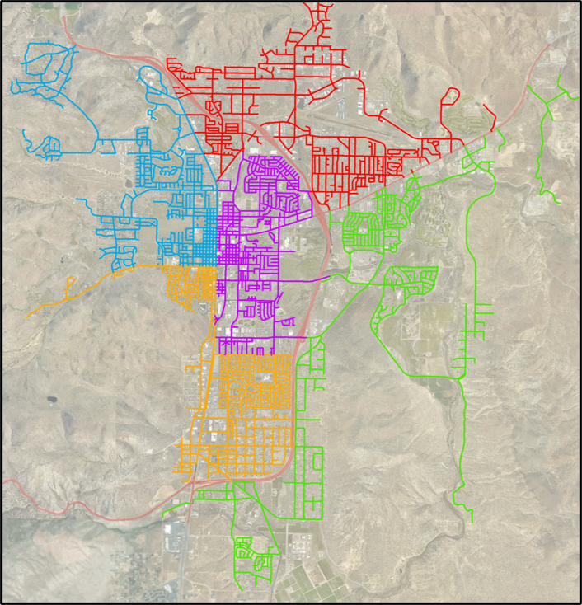
District project schedule
In accordance with 2024-2028 Pavement Preservation Plan
District Projects
Data Driven process and data we use to help inform the decision
Performance District Number​ | Year​
1 (Red)​ | 2024
2 (Purple)​ | 2025​
3 (Green)​ | 2026
4 (Orange)​ | 2027
5 (Blue)​ | 2028

Slide 19
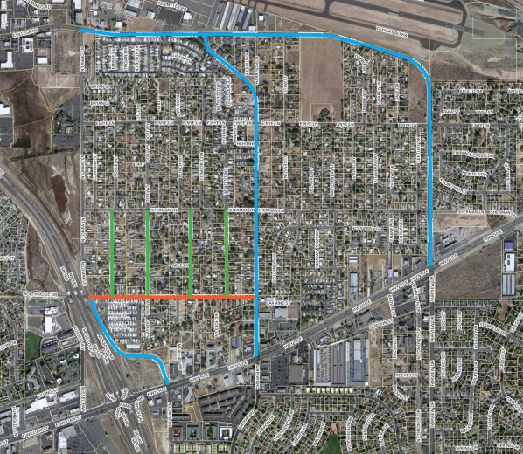

District 1 projects

Slide 20
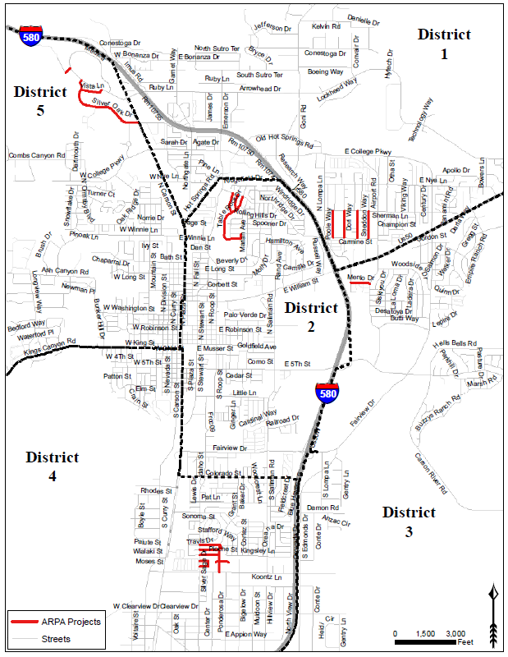
Arpa projects
District 5
  Completion 2023
Districts 1, 2, 3, 4
  Designed by September 2024
  Constructed Summer of 2025

Slide 21
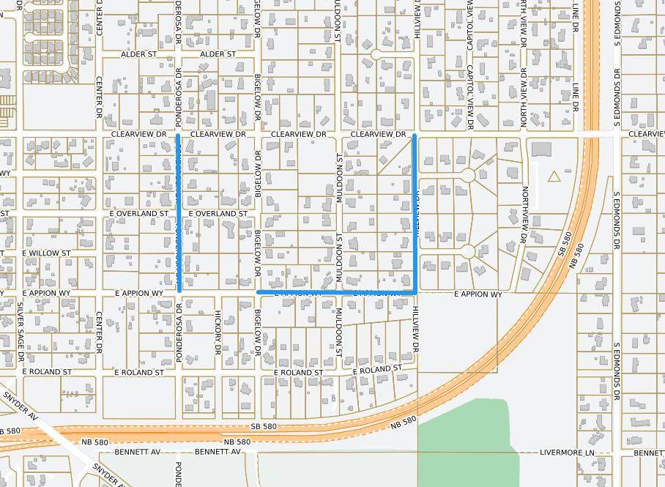
District 4 – Local roads
Waste Management Franchise Fee Funding ($400,000)
  E Appion Wy – Rehabilitation from Bigelow Dr to Hillview Dr (0.25 miles)
  Ponderosa Dr – Rehabilitation from E Appion Wy to Clearview Dr (0.25 miles)
  Hillview Dr – Half Street Rehabilitation from E Appion Wy to Clearview Dr (0.25 miles)

Slide 22
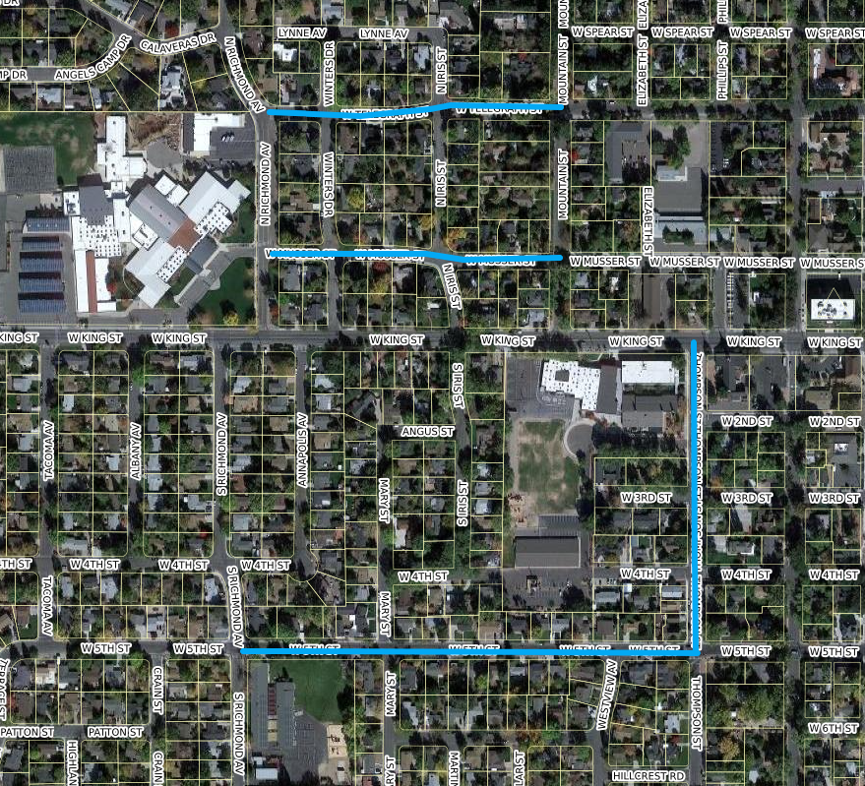
West Carson Vulnerable User Pedestrian Safety Improvement Project
Intersection Crossing Enhancements
Sidewalk Replacement and Gap Closures
ADA Compliance
Traffic Enhancements
  Speed Feedback Sign
Pavement Preservation

Slide 23
Future meetings
Open discussion
Next meeting planned for this Fall 2023.
Email blasts for some specific items.

Slide 24
Thank you!
Transportation division
Chris Martinovich, PE | transportation manager
775.283.7367
cmartinovich@carson.org

